Slide 1


What is Linux and its' applications?​
“Bad programmers worry about the code. Good programmers worry about data structures and their relationships”
Laurent Cai
Farzad Rashidi

Slide 2

Summary
“Bad programmers worry about the code. Good programmers worry about data structures and their relationships”
What is Linux ?
What are Linux’s Distribution ?
Differences between Linux and other’s systems
Benefits and deficits of Linux
Applications of Linux in our lives
Comparison of Linux and Windows/MacOS

Slide 3

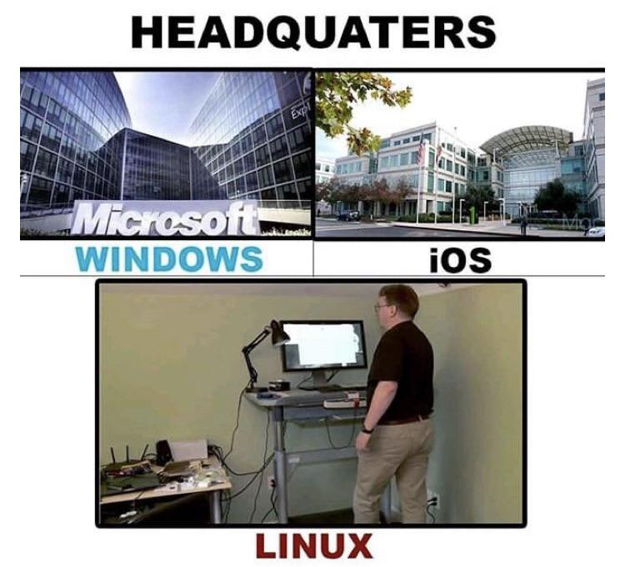
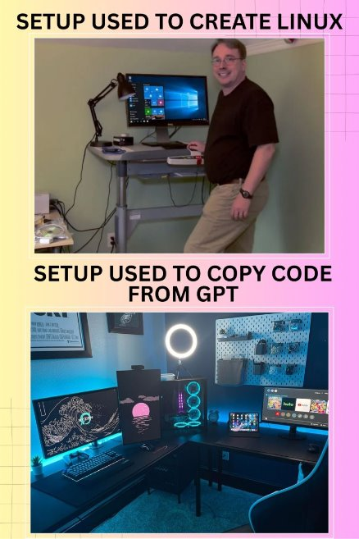
History
Linux is, in general, an operating system. It is originally a Unix-like operating system and was first released in September 1991 by Linus Torvalds, a professor at the University of Helsinki (Torvalds, 2001).
The goal of the creator of Linux was to create a lightweight and free operating system that could adapt to his student circumstances so that there was no need to upgrade the software or use paid systems (Raymond, 1999; Corbet et al., 2005).

Slide 4
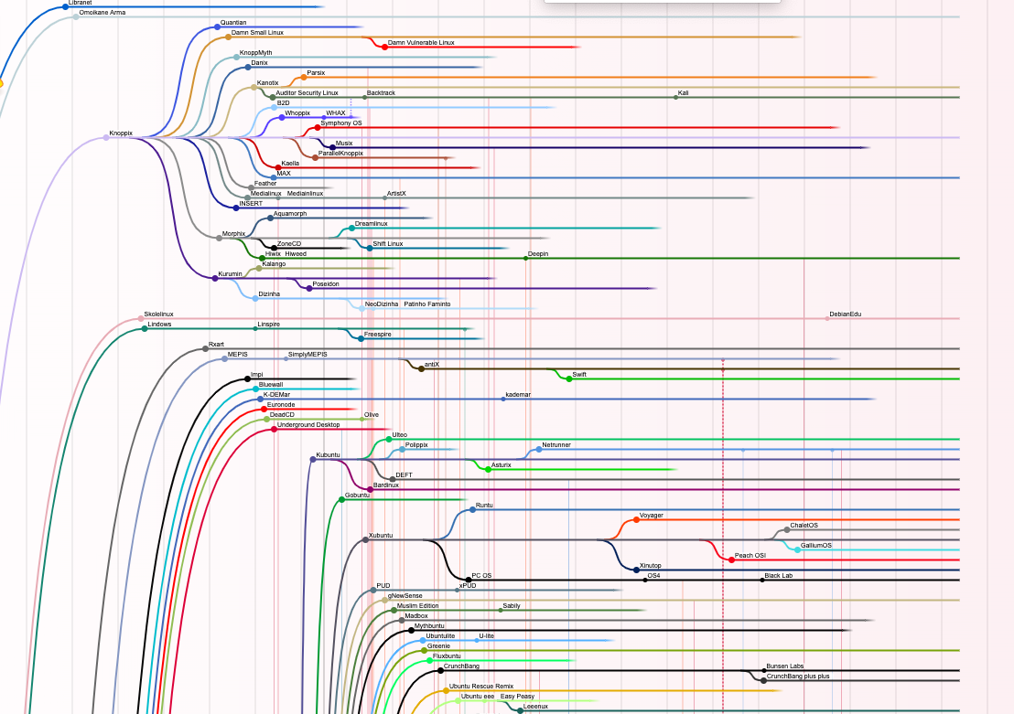
Linux’s Distribution
Distribution | Development model | Good for
Debian | High Stability | General user
Red Hat | The first priority is stability and security. | Suitable for servers and systems requiring high security
Arch | The first priority is to stay up to date. The user always wants to have the fastest and newest features. | Best suited for developers, power users, and those requiring the lightest system.
Linux has thousands of distributions that users customize and use depending on their needs and scope of work (Scachi, 200).

Slide 5

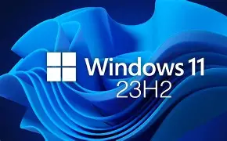

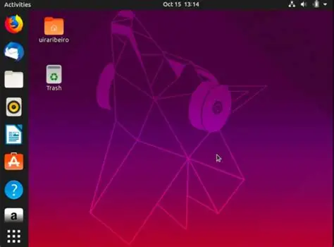
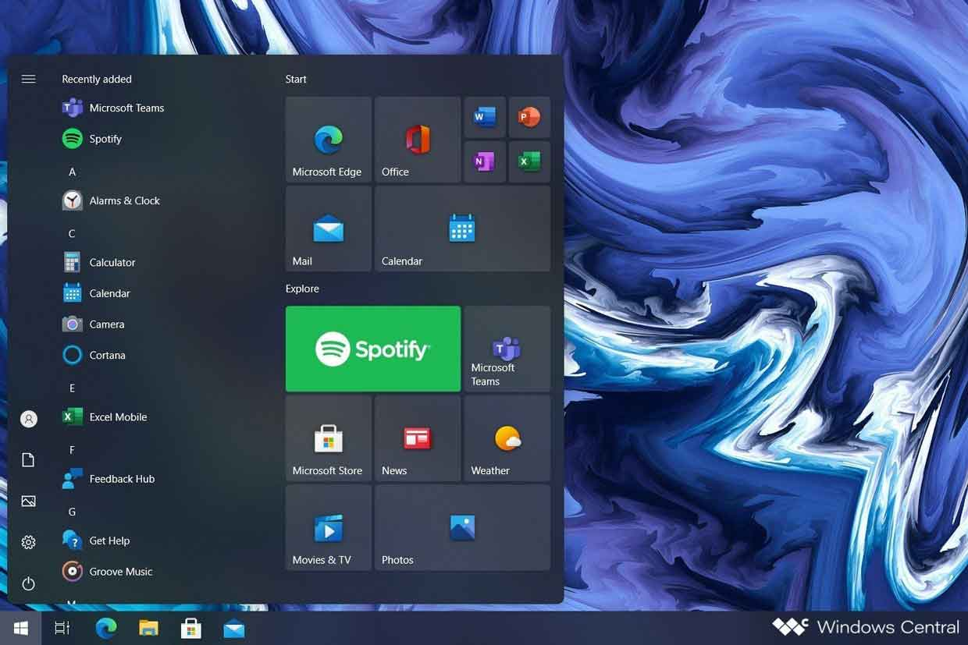
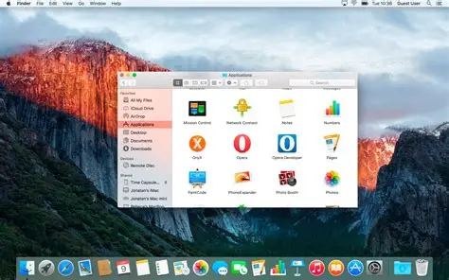
Difference between Linux and other OS
Windows
Linux
MacOs

Slide 6
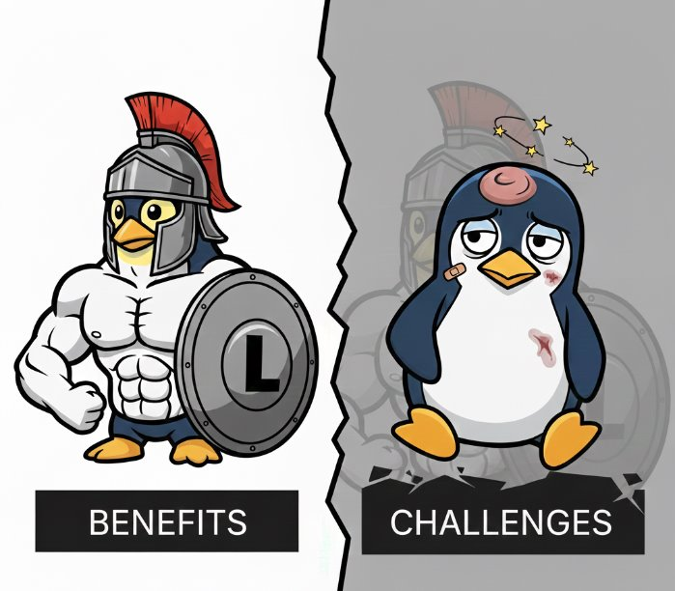
Benefits and deficits
Benefits | Deficits
Free and open | No unified support
Secure and stable | Software incompmtbiblity
Flexible and customizable | Complexity and steep learning curve

Slide 7

Applications in our lives
Smartphones (Android) Android: The kernel of the Android operating system is built directly on Linux. Millions of people use Linux in their pockets every day (Abbot, 2017).
Internet and web infrastructure Web servers: More than 90% of the world's web servers use Linux distributions (such as Red Hat and Ubuntu). Every time you open a website, you have used Linux services. Cloud: Large platforms such as Amazon, Google Cloud, and Microsoft Azure have built their core infrastructure on Linux (Abbot, 2017).
Modems and routers Modem and router: Your home Wi-Fi modems and routers often use very lightweight and optimized versions of Linux to manage the network (Abbot, 2017).

Slide 8



Comparaison

Slide 9

“Bad programmers worry about the code. Good programmers worry about data structures and their relationships”
Linus Torvalds

Slide 10
References
Quote : Bad programmers worry about the code. Good programmers worry about data structures and - Linus Torvalds | Quotation.io
Article : Cornell Virtual Workshop: An Introduction to Linux
Torvalds, L. (2001). Just for fun: The story of an accidental revolutionary. Harper Audio.
Corbet, J., Rubini, A., & Kroah-Hartman, G. (2005). Linux device drivers. " O'Reilly Media, Inc.".
Raymond, E. (1999). The cathedral and the bazaar. Knowledge, Technology & Policy, 12(3), 23-49.
Scacchi, W. (2004). Free and open source development practices in the game community. IEEE software, 21(1), 59-66.
Abbott, D. (2017). Linux for embedded and real-time applications. Newnes.
Part 3: Desktop Operating System Market Share Worldwide | Statcounter Global Stats
Part 6 : Selecting the Perfect OS for Your PC in 2025 » PcMobiTech

